Slide 1
DL Problem 2
Dominic Lee

Slide 2
Data pre-processing
Removed empty lines & Page number footers
Removed useless characters
Generated unique list of characters
Used sliding window technique to generate training and testing data
One hot encoded the data into a numeric form

Slide 3
Approach and Models
Universal workflow of machine learning
Systematic & Able to tune many parameters
RNN model & Non-RNN model
LSTM vs Bidirectional LSTM vs GRU
Conv1D
See how non-RNN model performs in a time-series problem

Slide 4
RNN Hyperparameters Tuned
LSTM vs GRU vs Bi-LSTM
Number of RNN layers & neurons in each RNN layer
Number of dense layers & neurons in each Dense layer
Layer Normalization
Dropout
Regularizers

Slide 5
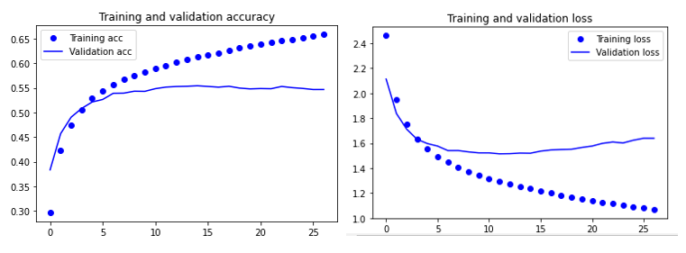
Initial Model
Initial Bidirectional LSTM baseline model
Validation Acc ~ 55%
Overfits ~ Epoch 15

Slide 6


Training Summary

Slide 7

Training Summary

Slide 8

Training Summary

Slide 9
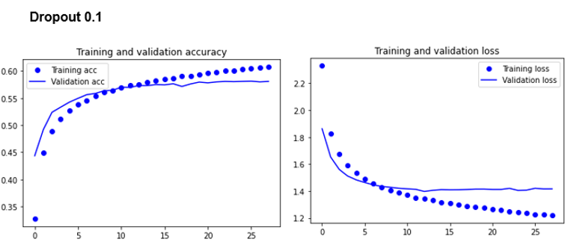
Analysis of text generation
Actual English words produced
Punctuation used appropriately
Sentences have poor grammar and no meaning
Has some form of structure
Context of Harry Potter

Slide 10
Conv1D Hyperparameters Tuned
Number of Conv1D layers & filters in each layer
Number of Dense layers & neurons in each layer
Learning Rate
Kernel Size
Batch Normalization
Dropout

Slide 11
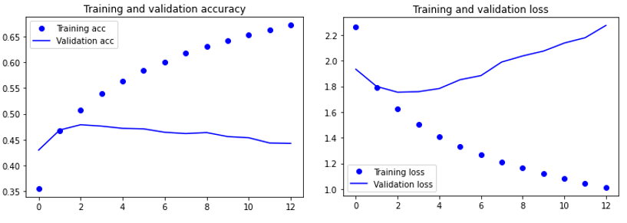
Initial Model
Initial Conv1D baseline model
Validation Acc ~ 47%
Overfits ~ Epoch 3

Slide 12

Training Summary

Slide 13
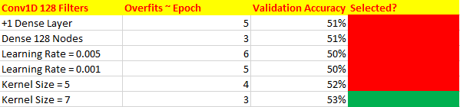

Training Summary

Slide 14
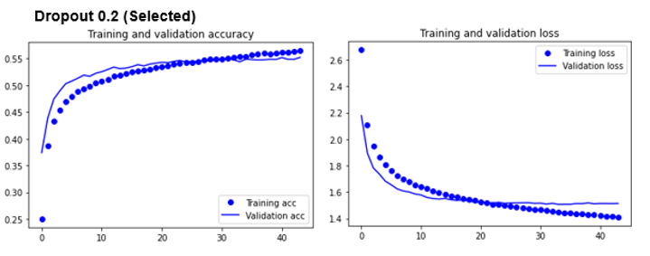
Analysis of text generation
Quality of text generated
Similar to the RNN Model
RNN Model selected as validation accuracy is higher
Theoretically better

Slide 15
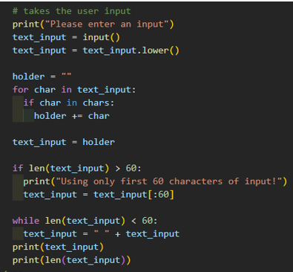
Model Predictions
Inputs from a user that is not from the book
Length must be 60 characters long
Pre-pad with whitespaces
Post-truncate inputs that are too long
Clean text

Slide 16
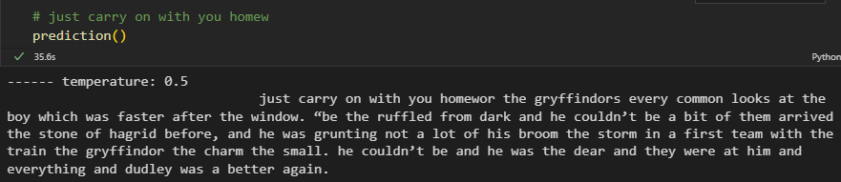
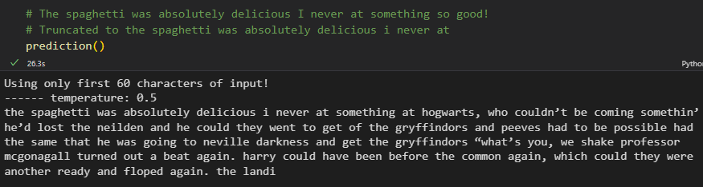
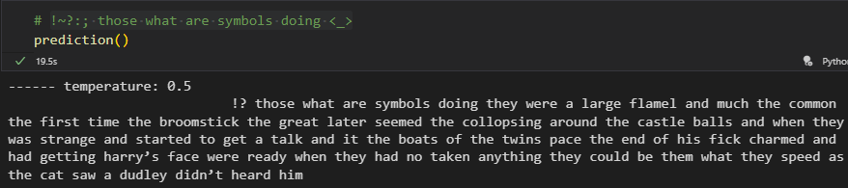

Slide 17
Quality of generated text (predictions)
Model could not make insightful predictions that related to the context of the inputs
Could not generate sentences with meaning
Structure of sentence were somewhat present
Produces actual English words
Use punctuation rather appropriately

Slide 18
Further improvements
Use another Harry Potter book for more data
Test a larger number of models e.g., GRU
Test more hyperparameters (width and depth)
Modify the model to be able to accept inputs of any length

